Slide 1
A Bag Implementation that Links Data
Chapter 3
Data Structures and Abstractions with Java, 4e
Frank Carrano
© 2015 Pearson Education, Inc., Upper Saddle River, NJ. All rights reserved.

Slide 2
What Is an Iterator?
An object that traverses a collection of data
During iteration, each data item is considered once
  Possible to modify item as accessed
Should implement as a distinct class that interacts with the ADT
© 2015 Pearson Education, Inc., Upper Saddle River, NJ. All rights reserved.

Slide 3
Problems with Array Implementation
Array has fixed size
May become full
Alternatively may have wasted space
Resizing is possible but requires overhead of time
© 2015 Pearson Education, Inc., Upper Saddle River, NJ. All rights reserved.

Slide 4
Analogy
Empty classroom
Numbered desks stored in hallway
  Number on back of desk is the “address”
Number on desktop references another desk in chain of desks
Desks are linked by the numbers
© 2015 Pearson Education, Inc., Upper Saddle River, NJ. All rights reserved.

Slide 5
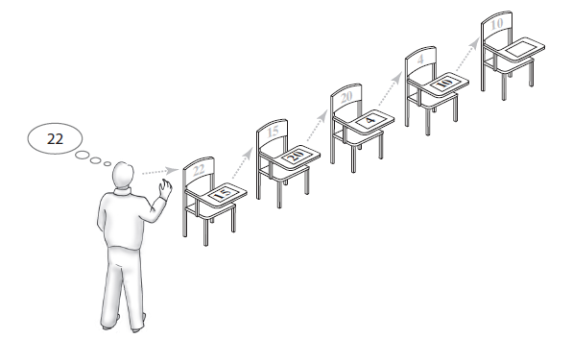
Analogy
FIGURE 3-1 A chain of five desks
© 2015 Pearson Education, Inc., Upper Saddle River, NJ. All rights reserved.

Slide 6
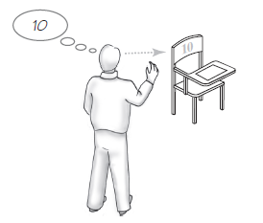
Forming a Chain by Adding to Its Beginning
FIGURE 3-2 One desk in the room
© 2015 Pearson Education, Inc., Upper Saddle River, NJ. All rights reserved.

Slide 7
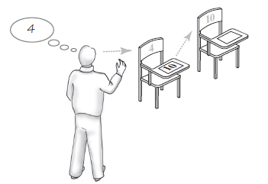
Forming a Chain by Adding to Its Beginning
FIGURE 3-3 Two linked desks, with the newest desk first
© 2015 Pearson Education, Inc., Upper Saddle River, NJ. All rights reserved.

Slide 8
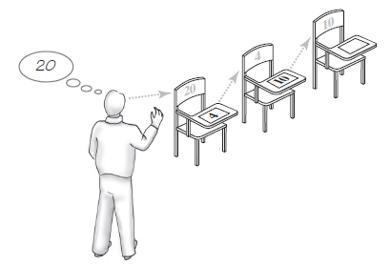
Forming a Chain by Adding to Its Beginning
FIGURE 3-4 Three linked desks, with the newest desk first.
© 2015 Pearson Education, Inc., Upper Saddle River, NJ. All rights reserved.

Slide 9
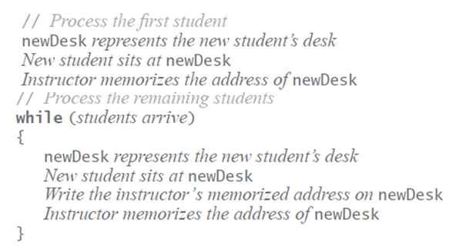
Forming a Chain by Adding to Its Beginning
Pseudocode details the steps taken to form a chain of desks
© 2015 Pearson Education, Inc., Upper Saddle River, NJ. All rights reserved.

Slide 10
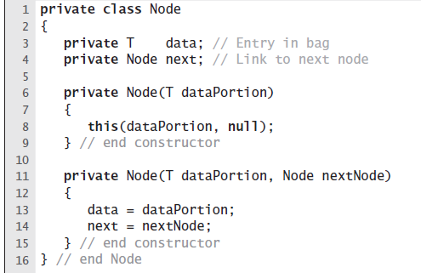
The Private Class Node
LISTING 3-1 The private inner class Node
© 2015 Pearson Education, Inc., Upper Saddle River, NJ. All rights reserved.

Slide 11
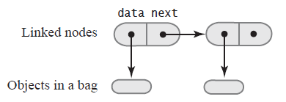
The Private Class Node
FIGURE 3-5 Two linked nodes that each reference object data
© 2015 Pearson Education, Inc., Upper Saddle River, NJ. All rights reserved.

Slide 12
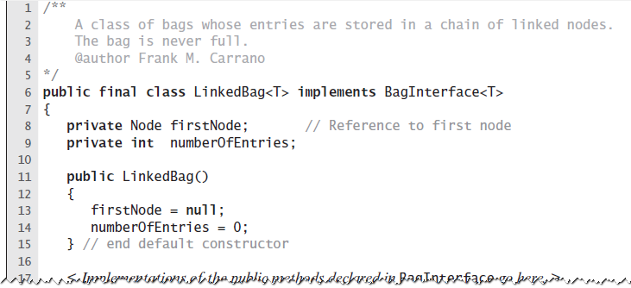
An Outline of the Class LinkedBag
LISTING 3-2 An outline of the class LinkedBag
© 2015 Pearson Education, Inc., Upper Saddle River, NJ. All rights reserved.

Slide 13
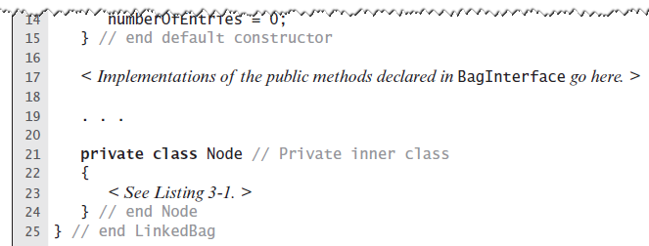
An Outline of the Class LinkedBag
LISTING 3-2 An outline of the class LinkedBag
© 2015 Pearson Education, Inc., Upper Saddle River, NJ. All rights reserved.

Slide 14
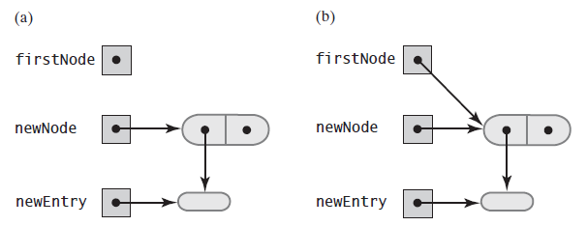
Beginning a Chain of Nodes
FIGURE 3-6 (a) An empty chain and a new node; (b) after adding a new node to a chain that was empty
© 2015 Pearson Education, Inc., Upper Saddle River, NJ. All rights reserved.

Slide 15
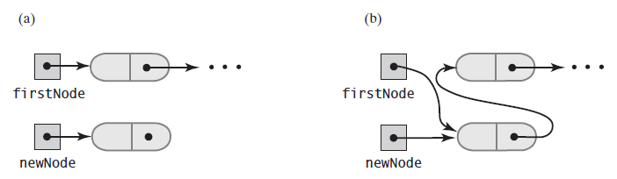
Beginning a Chain of Nodes
FIGURE 3-7 A chain of nodes (a) just prior to adding a node at the beginning; (b) just after adding a node at the beginning
© 2015 Pearson Education, Inc., Upper Saddle River, NJ. All rights reserved.

Slide 16
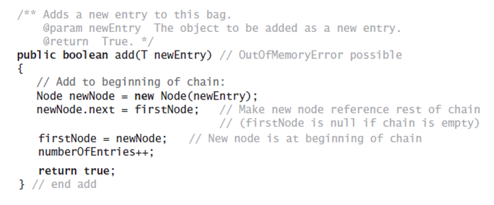
Beginning a Chain of Nodes
The method add
© 2015 Pearson Education, Inc., Upper Saddle River, NJ. All rights reserved.

Slide 17
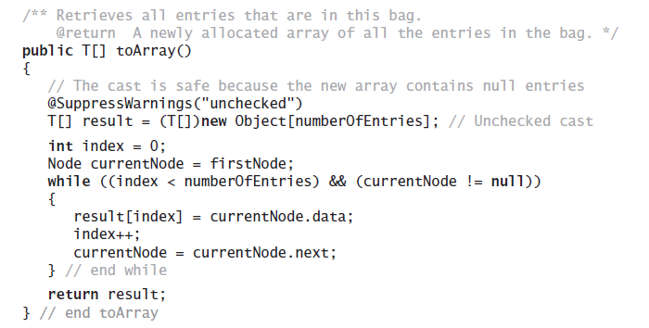
Method toArray
The method toArray returns an array
of the entries currently in a bag
© 2015 Pearson Education, Inc., Upper Saddle River, NJ. All rights reserved.

Slide 18
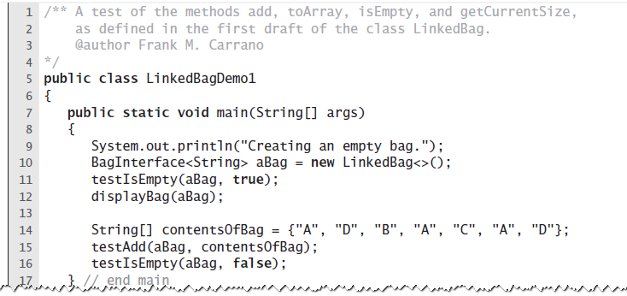
Test Program
LISTING 3-3 A sample program that tests some methods in the class LinkedBag
© 2015 Pearson Education, Inc., Upper Saddle River, NJ. All rights reserved.

Slide 19
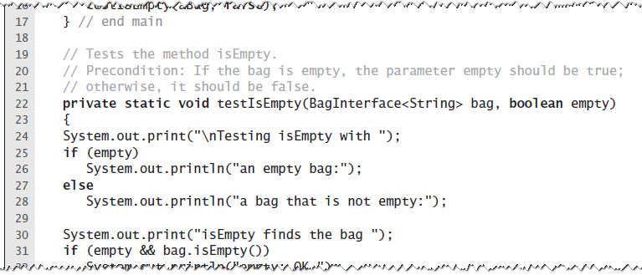
Test Program
LISTING 3-3 A sample program that tests some methods in the class LinkedBag
© 2015 Pearson Education, Inc., Upper Saddle River, NJ. All rights reserved.

Slide 20
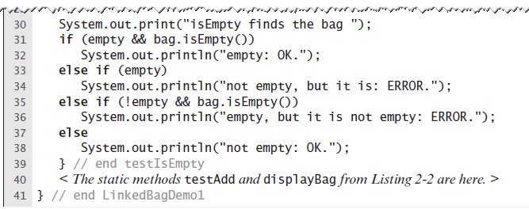
Test Program
LISTING 3-3 A sample program that tests some methods in the class LinkedBag
© 2015 Pearson Education, Inc., Upper Saddle River, NJ. All rights reserved.

Slide 21
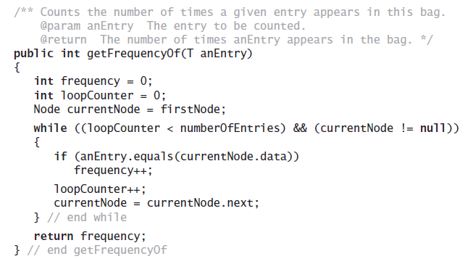
Method getFrequencyOf
Counts the number of times a given entry appears
© 2015 Pearson Education, Inc., Upper Saddle River, NJ. All rights reserved.

Slide 22
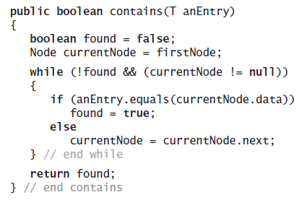
Method contains
Determine whether a bag contains a given entry
© 2015 Pearson Education, Inc., Upper Saddle River, NJ. All rights reserved.

Slide 23
Removing an Item from a Linked Chain
Case 1: Your desk is first in the chain of desks.
Case 2: Your desk is not first in the chain of desks.
© 2015 Pearson Education, Inc., Upper Saddle River, NJ. All rights reserved.

Slide 24
Removing an Item from a Linked Chain
Case 1
Locate first desk by asking instructor for its address.
Give address written on the first desk to instructor. This is address of second desk in chain.
Return first desk to hallway.
© 2015 Pearson Education, Inc., Upper Saddle River, NJ. All rights reserved.

Slide 25
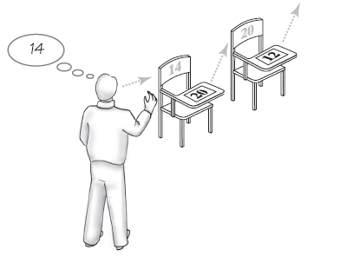
Removing an Item from a Linked Chain
FIGURE 3-8 A chain of desks just prior
to removing its first desk
© 2015 Pearson Education, Inc., Upper Saddle River, NJ. All rights reserved.

Slide 26
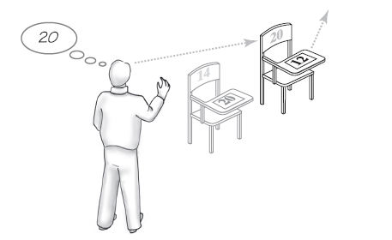
Removing an Item from a Linked Chain
FIGURE 3-9 A chain of desks just
after removing its first desk
© 2015 Pearson Education, Inc., Upper Saddle River, NJ. All rights reserved.

Slide 27
Removing an Item from a Linked Chain
Case 2
Move the student in the first desk to your former desk.
Remove the first desk using the steps described for Case 1.
© 2015 Pearson Education, Inc., Upper Saddle River, NJ. All rights reserved.

Slide 28
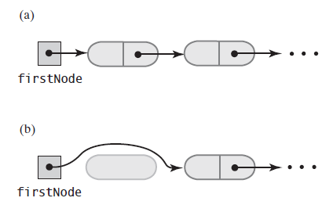
Removing an Item from a Linked Chain
FIGURE 3-10 A chain of nodes (a) just prior to removing the first node; (b) just after removing the first node
© 2015 Pearson Education, Inc., Upper Saddle River, NJ. All rights reserved.

Slide 29
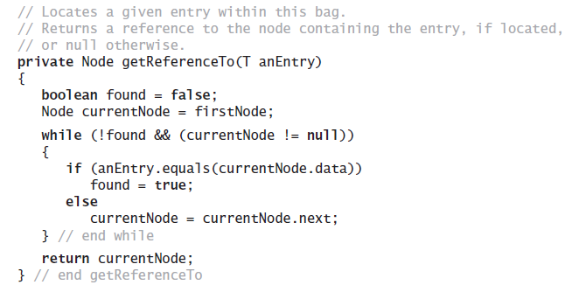
Method remove
Note need for private method getReferenceTo
© 2015 Pearson Education, Inc., Upper Saddle River, NJ. All rights reserved.

Slide 30
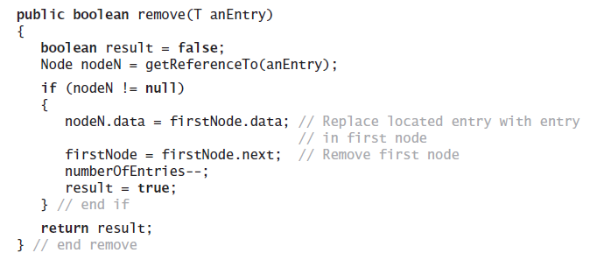
Method remove
Note use of method getReferenceTo
© 2015 Pearson Education, Inc., Upper Saddle River, NJ. All rights reserved.

Slide 31
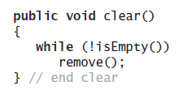
Method clear
As in previous implementation,
uses isEmpty and remove
© 2015 Pearson Education, Inc., Upper Saddle River, NJ. All rights reserved.

Slide 32
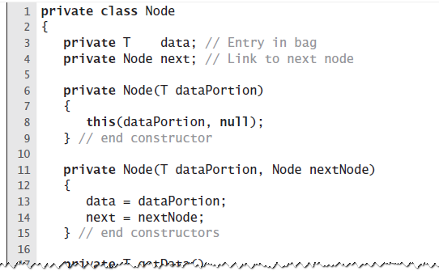
Class Node That
Has Set and Get Methods
LISTING 3-4 The inner class Node
with set and get methods
© 2015 Pearson Education, Inc., Upper Saddle River, NJ. All rights reserved.

Slide 33
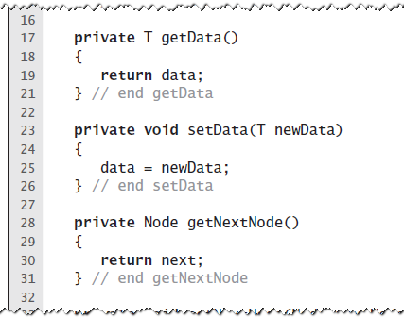
Class Node That
Has Set and Get Methods
LISTING 3-4 The inner class Node
with set and get methods
© 2015 Pearson Education, Inc., Upper Saddle River, NJ. All rights reserved.

Slide 34
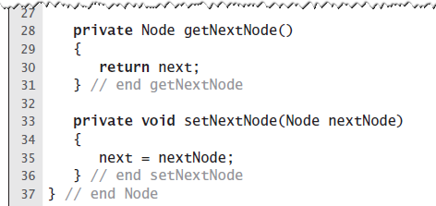
Class Node That
Has Set and Get Methods
LISTING 3-4 The inner class Node
with set and get methods
© 2015 Pearson Education, Inc., Upper Saddle River, NJ. All rights reserved.

Slide 35
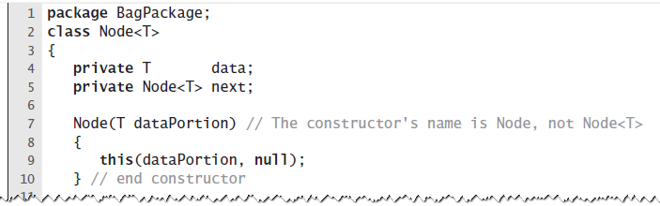
A Class within A Package
LISTING 3-5 The class Node with package access
© 2015 Pearson Education, Inc., Upper Saddle River, NJ. All rights reserved.

Slide 36
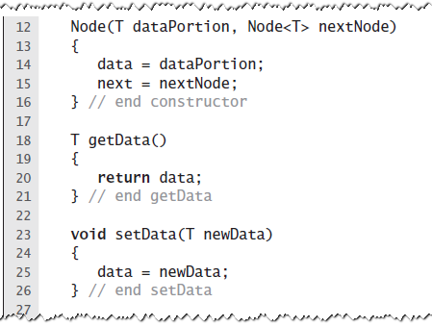
A Class within A Package
LISTING 3-5 The class Node with package access
© 2015 Pearson Education, Inc., Upper Saddle River, NJ. All rights reserved.

Slide 37
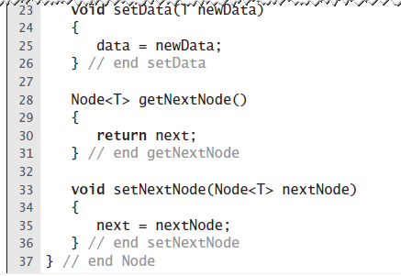
A Class within A Package
LISTING 3-5 The class Node with package access
© 2015 Pearson Education, Inc., Upper Saddle River, NJ. All rights reserved.

Slide 38
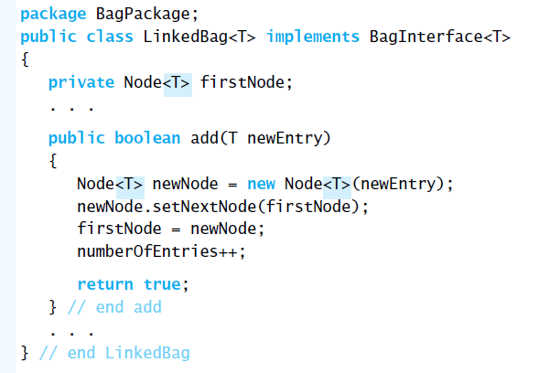
When Node Is in Same Package
This occurrence of T is optional
LISTING 3-6 The class LinkedBag when
Node is in the same package
© 2015 Pearson Education, Inc., Upper Saddle River, NJ. All rights reserved.

Slide 39
Pros of Using a Chain
Bag can grow and shrink in size as necessary.
Remove and recycle nodes that are no longer needed
Adding new entry to end of array or to beginning of chain both relatively simple
Similar for removal
© 2015 Pearson Education, Inc., Upper Saddle River, NJ. All rights reserved.

Slide 40
Cons of Using a Chain
Removing specific entry requires search of array or chain
Chain requires more memory than array of same length
© 2015 Pearson Education, Inc., Upper Saddle River, NJ. All rights reserved.

Slide 41
End
Chapter 3
© 2015 Pearson Education, Inc., Upper Saddle River, NJ. All rights reserved.

